Slide 1


PRESENTATION
FOR LADIES DEPARTMENT

Slide 2
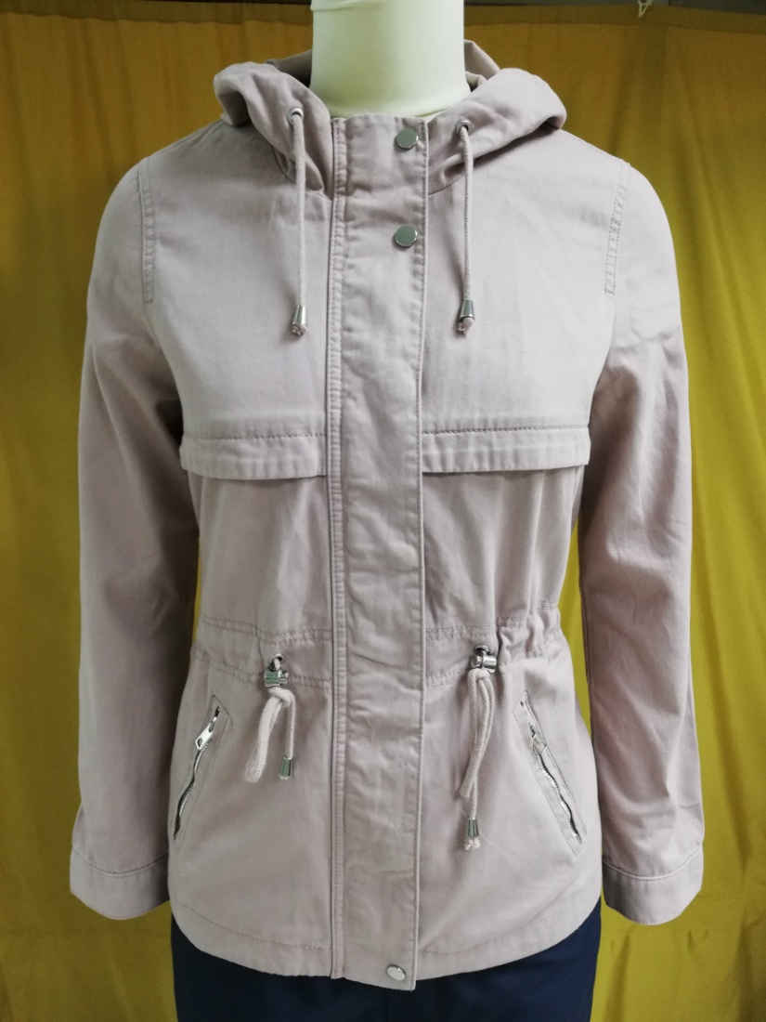
BUYER-H&M
STYLE: Falcon Parka
Shell: 100% Cotton Twill
Fiber filling :N/A
Item : Women's JKT
wash: ENZ
FOB $ : 14.00

Slide 3

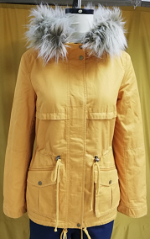
BUYER-H&M
STYLE: Carla Parka
Shell: 100% Cotton Twill
Item : Women's JKT
FOB $ : 16.50
Wash : ENZ

Slide 4
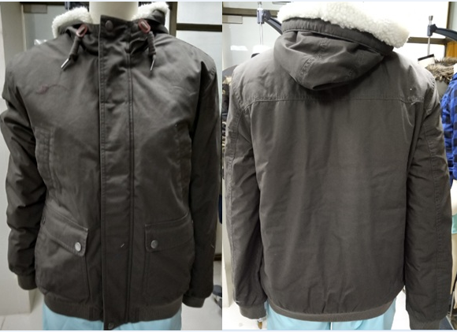

Style:2054890 TODEY
Item: Ladies Jacket
Fabric: 100% Cotton Canvas With Enzyme Wash.
Buyer: C&A
FOB:$15
MOQ : 5000 pcs
:

Slide 5
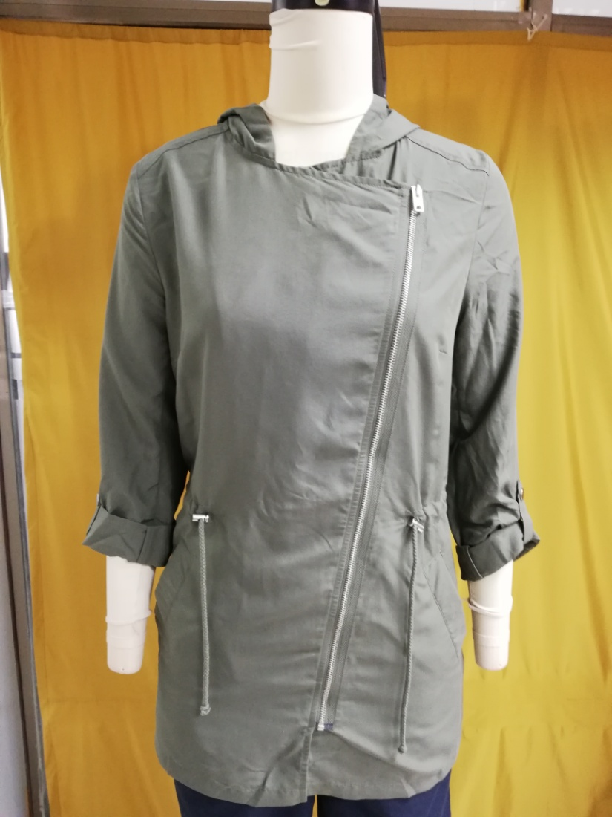
BUYER-H&M
STYLE: Peach Parka
Shell: viscose 72% 28% polyester.
Fiberfill: N/A
Item : Women's JKT
Non wash
FOB $ : 10.50

Slide 6
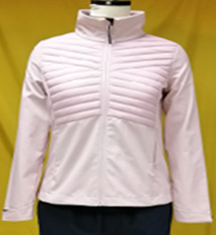
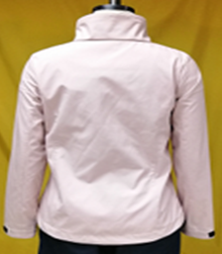
Buyer:OTCF
Style: D4Z19-SFD302 (Women Soft Shell Jacket)
Shell: Body-1: 100 % Polyester Woven Fabric Bonded With 100% Polyester Interlock, Membrane: TPU Lamination Wp 8000/ MVP 6000, DWR Finishing , Body-2:100% Polyamide Full Dull 20D*20D 380T (Matt & DWR Finishing)
Tricot: 100% Polyester Tricot
Padding: 100% Polyester Fake Down
Fob: $ / Pcs.16.70

Slide 7
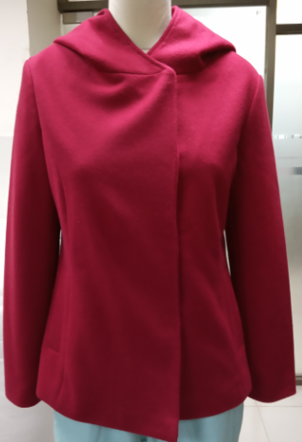
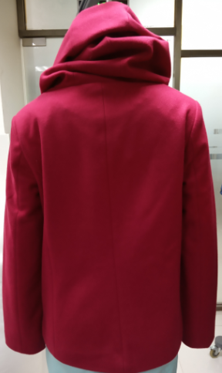
Buyer: C&A
STYLE: Wenka Jacket
Shell: viscose 78% polyester, 11%Rayon,11%Acrle
Lining:100%Polyester 210T
Fiberfill: N/A
Item : Women's JKT
Non wash
FOB $ :15.60

Slide 8

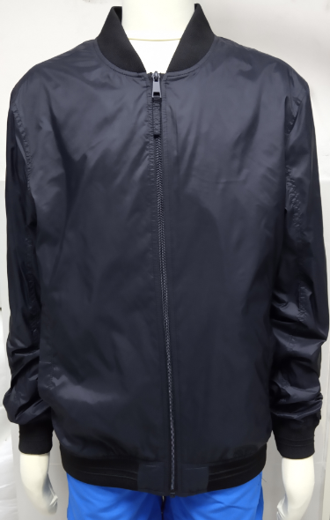
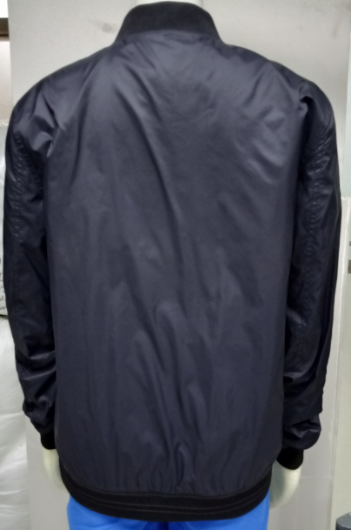
L
BUYER:C&A
FOB:7.60
STYLE:1/2012/01004/001
SHELL FABRIC:100 % NYLON
LINING FABRIC:100 % POLYESTER 210T
TAFFETA
FOB:6.9500

Slide 9
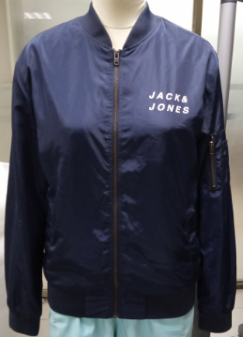
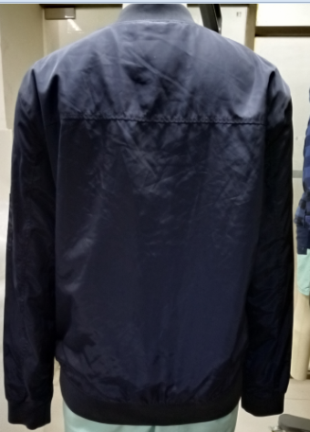
Buyer:Jack & Jones
STYLE: JCOSNIPE
Shell: 100% Cotton Twill
Item : Women's JKT
Enzyme wash
FOB $ : 11.70

Slide 10
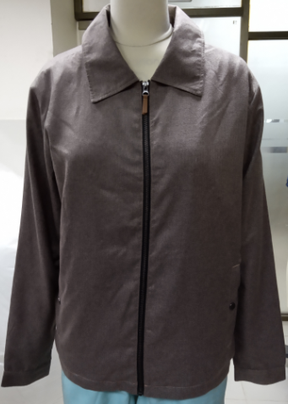
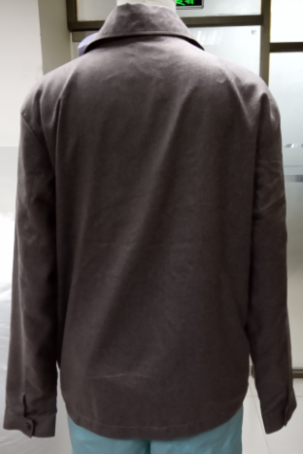
Buyer: C&A
STYLE:19/2/2023/0100415
Shell: 100%Polyester
Lining:100%Polyester 210T AOP
Item : Women's JKT
Enzyme wash
FOB $ :14.41

Slide 11
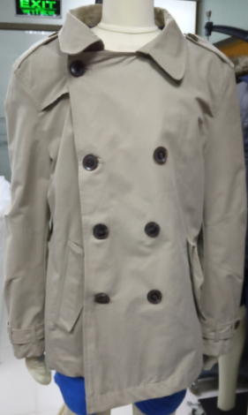
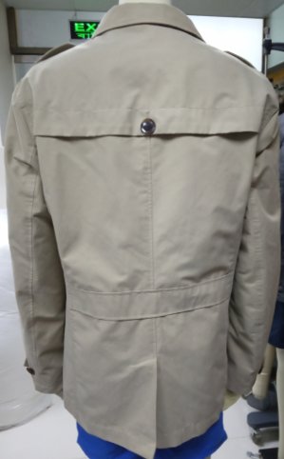
Buyer: TEMA
STYLE:TRENS COAT
Shell: 70% Cotton,30%P[olyester
Item : Women's JKT
WASH
FOB $ :14.00

Slide 12
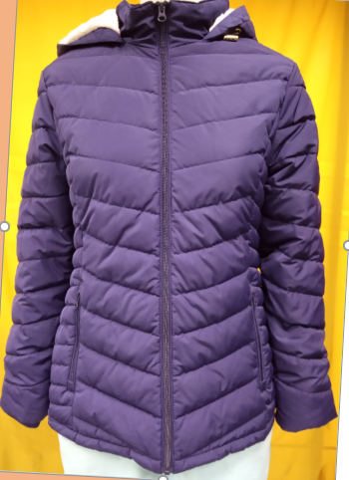

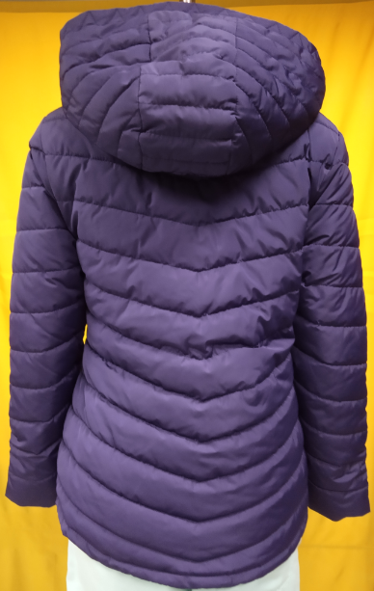
BUYER: WALMART
STYLE:525/5250/0444/002/0011
FABRIC:100% POLYESTER FAKE MEMOROY
PADDING:100% POLYESTER FAKE DOWN
FOB:$14.37

Slide 13
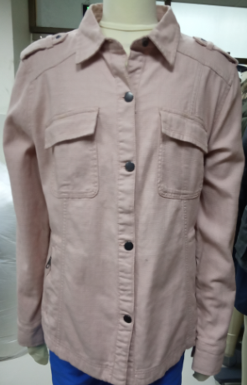
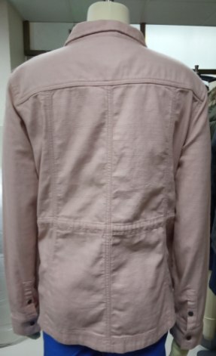
Buyer: NEXT
STYLE:SHIRT JACKET
Shell: 100% Cotton Dobby Strike
Item : Women's JKT
WASH
FOB $ : 16.11

Slide 14
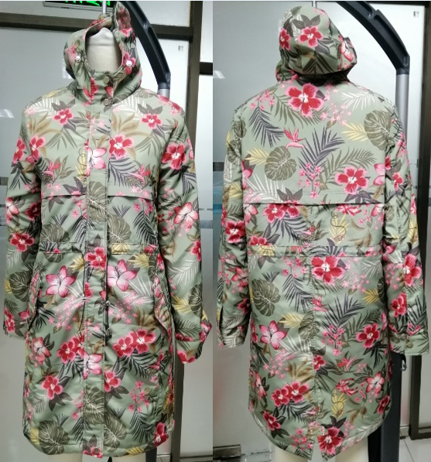

Style: KPD 125
Item: Women’s Lone coat Jacket
Fabric: 100%Polyester Fake Memory
Buyer: LPP
FOB: $ 14.00
MOQ:5000

Slide 15

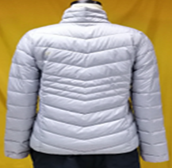
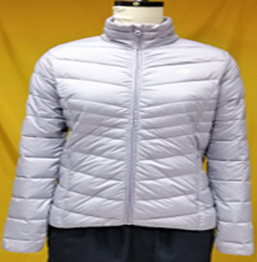
BUYER:OTCF
STYLE: H4Z19 - KUDP003
FABRIC: 100% Polyester Melange Full Dull 30D*30D 380T (Matt & DWR Finishing
PADDING: 100% Polyester Fake Down & Collar & Bottom: 80 GSM
FOB:$

Slide 16
Thank You

